Slide 1
DEPARTMENT OF PHYSICS
PHYSICS WORKSHOP SKILL
COURSE CODE- PHYS203
DRILLING MACHINE
PRESENTED BY-
PROF. HEM CHAND

Slide 2
Drilling machine

Slide 3
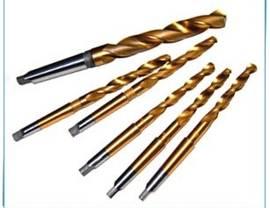
Introduction
Drilling is a metal cutting process carried out by a rotating cutting tool to make circular holes in solid materials.
Tool which makes hole is called as drill bit or twist drill.

Slide 4
Drilling machine
^{ν} A power operated machine tool which holds the drill in its spindle rotating at high speeds and when actuated move linearly against the work piece produces a hole.

Slide 5
Types of drilling machine.
Portable drilling machine
Bench drilling machine
Radial drilling machine
Pillar drilling machine
Gang drilling machine
Multiple drilling machine

Slide 6
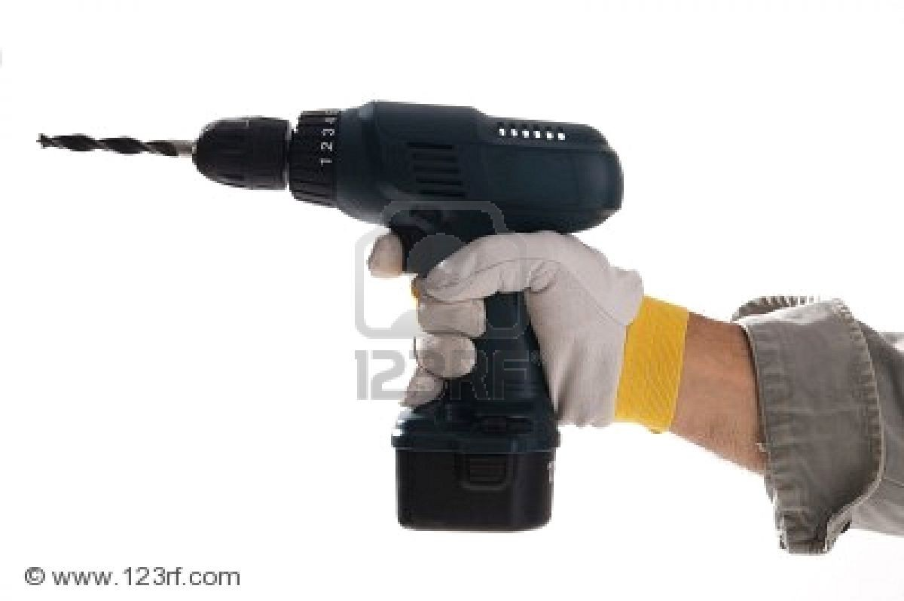
Portable drilling machine

Slide 7
Bench drilling machine
These are light duty machines used in small workshops.
Also called Sensitive drilling machines because of its accurate and well balanced spindle.
Holes of diameter 1 mm to 15 mm.

Slide 8
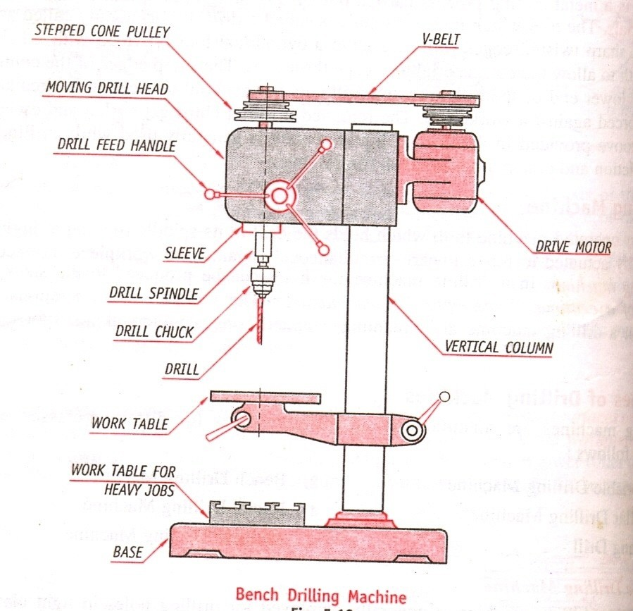
Bench drilling machine

Slide 9
parts
Vertical main column
Base
Moving drill head
Work table
Electric motor
Variable speed gear box and spindle feed mechanism.

Slide 10
working
^{ν} Work piece with the exact location
marked on it with the centre punch is clamped rigidly on the work table.
spindle axis and center punch indentation are in same line.
ν
Machine is started and drill bit is lowered by rotating feed handle.
Drill bit touches the work and starts removing material.

Slide 11
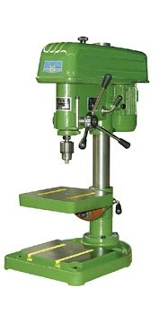
Bench drilling machine

Slide 12
Radial drilling machine
These are heavy duty and versatile drilling machine used to perform drilling operate on large and heavy work piece.
Holes up to 7.5 cm.

Slide 13
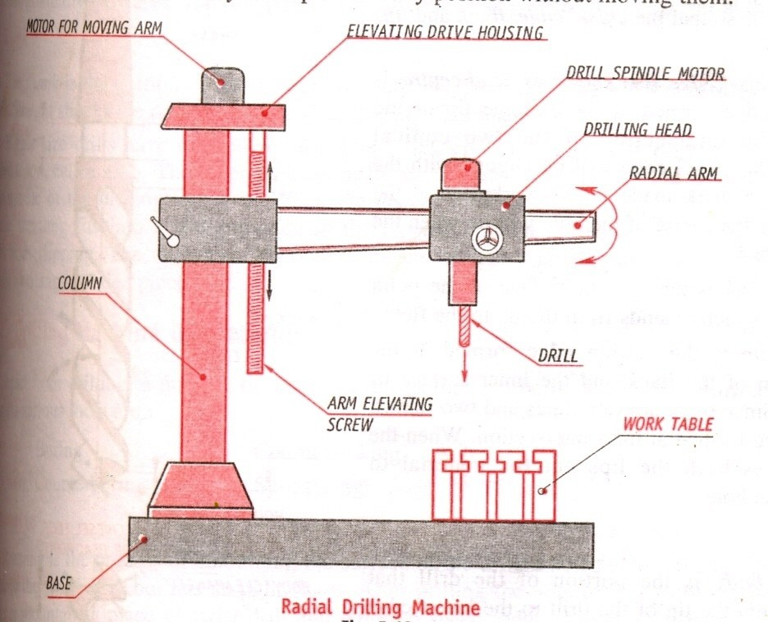
Radial drilling machine

Slide 14
parts
Heavy base
Vertical column
Horizontal arm
Drilling head

Slide 15
working
Work piece is marked for exact location and mounted on the work table.
Drill bit is then located by moving the radial arm and drill to the marked location.
By starting drill spindle motor holes are drilled.

Slide 16
Drilling machine operation
Reaming
Boring
Counter boring
Counter sinking
Spot facing
Tapping

Slide 17
Reaming
It is a process of smoothing the surface of drilled holes with a tool.
Tool is called as reamer.
Initially a hole is drilled slightly smaller in size.
Drill is replaced by reamer.
Speed is reduced to half that of the drilling.

Slide 18
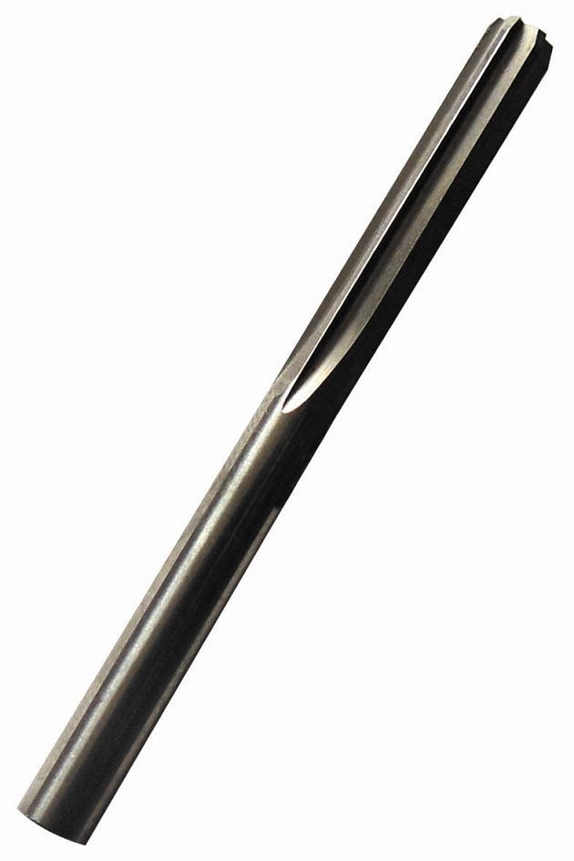
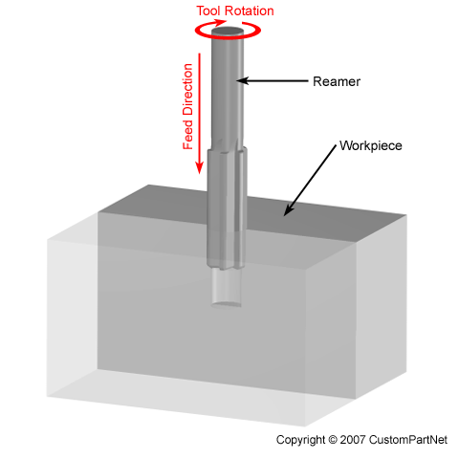
Reaming

Slide 19
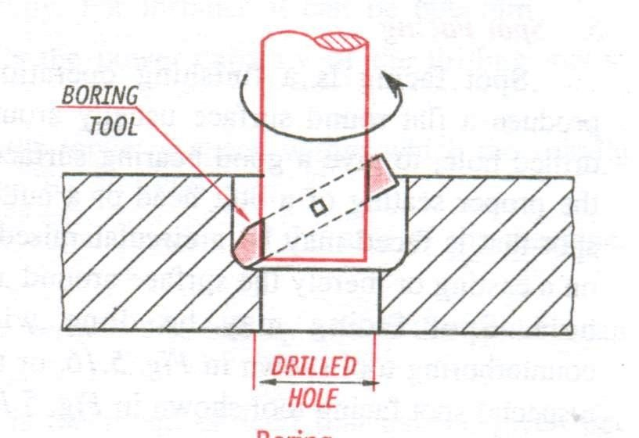
Boring
It is process carried on a drilling machine to increase the size of an already drilled hole.
Initially a hole is drilled to the nearest size and using a boring tool the size of the hole is increased.

Slide 20
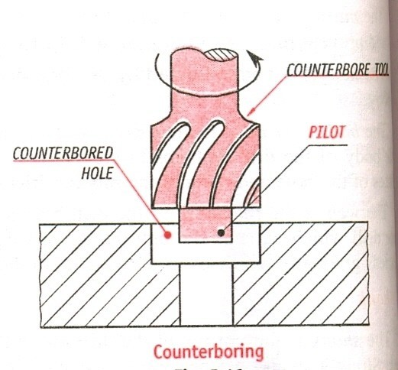
Counter boring
This process involves increasing the size of a hole at only one end.
Cutting tool will have a small cylindrical portion called pilot.
Cutting speed = two- thirds of the drilling speed for the same hole.

Slide 21
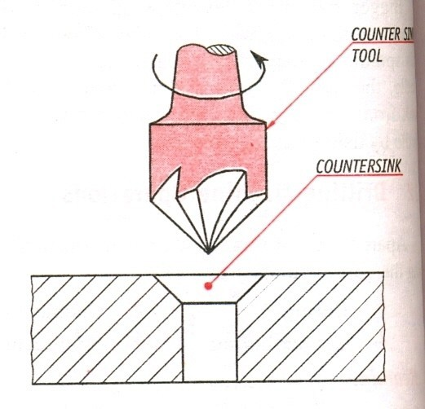
Counter sinking
This is an operation of making the end of a hole into a conical shape.
Cutting speed = half of the cutting speed of drilling for same hole.

Slide 22
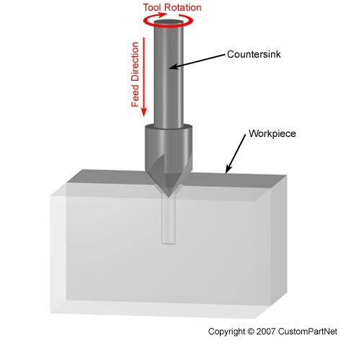
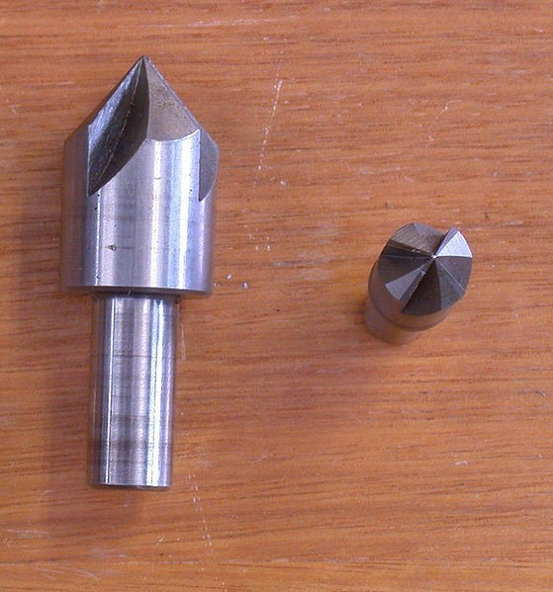

Slide 23
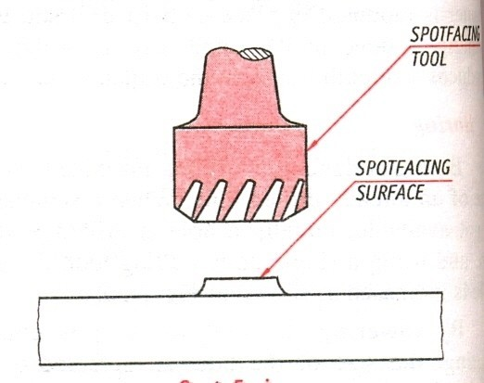
Spot facing
It is a finishing operation to produce flat round surface usually around a drilled hole, for proper seating of bolt head or nut.
It is done using a special spot facing tool.

Slide 24
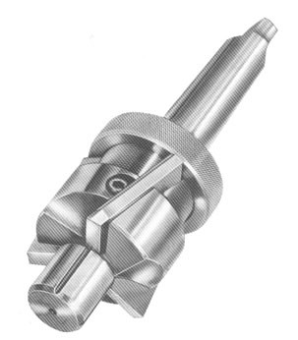
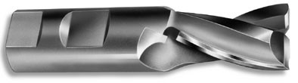

Slide 25
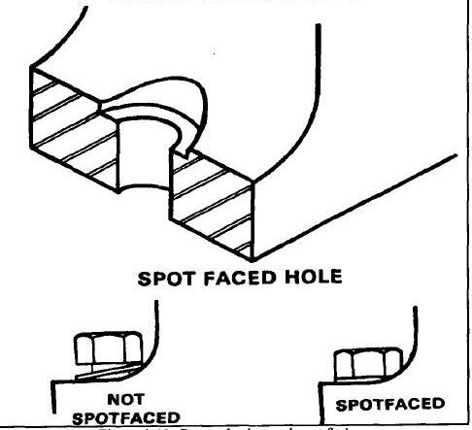

Slide 26
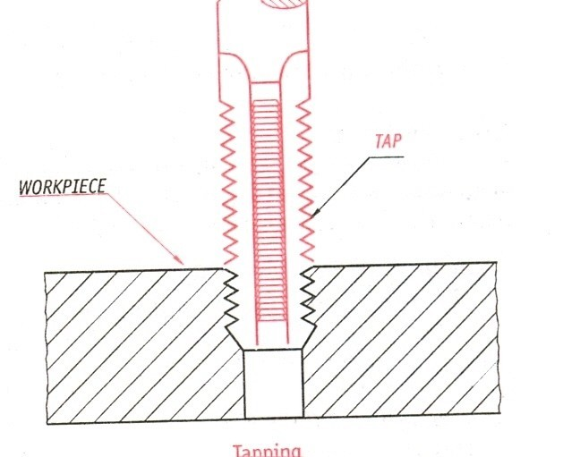
Tapping
Process of cutting internal threads with a thread tool called as tap.
Tap is a fluted threaded tool used for cutting internal thread
Cutting speed is very slow.

Slide 27
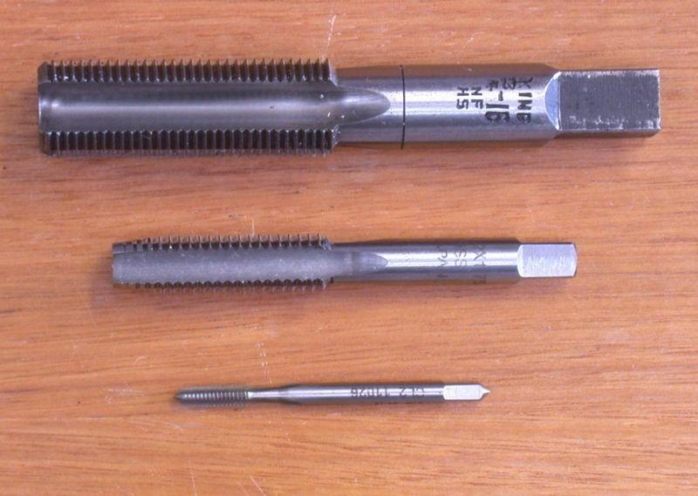

Slide 28
Specification of a radial drilling machine
^{ν} Power capacity eg:
1.5 hp for drilling motor and 0.5 hp for elevating motor.
^{ν} The range of speed of spindle eg: 50 to 2800 rpm.

Slide 29
Length of arm on which drill head can traverse. eg: 600 mm.
Vertical movement of the arm eg: 500 mm.
Angular swing of arm eg: 360˚

Slide 30
ν Range to which drill bit can reach eg: 350 mm to 900 mm.
ν Drill depth eg: 32 mm for steel.

Slide 31


